Slide 1


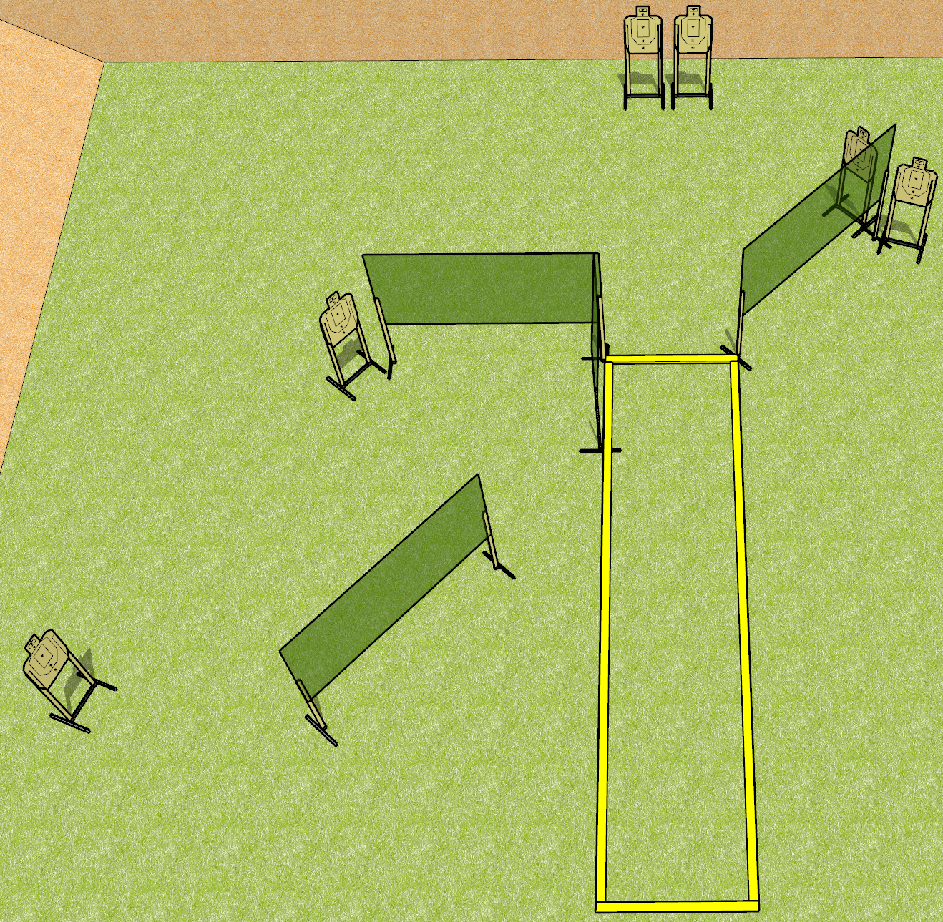
 | Dothan Gun Club – USPSA Match Moving the Standard Course Designer : Drew Coleman
Round Count 24 rounds 6 USPSA targets
Equipment List 7 wall feet 2 medium fault lines 4 10’ fault lines

Slide 2
Moving the Standard
Written Stage Briefing
Moving the Standard is a 24 round, 120 point, Virginia Count standard exercise. There are 6 USPSA targets. The best 4 hits on paper will score. The start signal is audible.
Handgun start position is heels touching rear fault line for string 1, and toes touching front fault line for string 2, wrists below belt. Handgun is loaded and holstered.
PCC start position heels touching rear fault line for string 1, and toes touching front fault line for string 2. Loaded carbine is held with both hands, stock on belt, safety on.
String 1 stage procedure: on start signal, from within the shooting area, engage any 3 targets with only 2 rounds each, perform a mandatory reload, and engage remaining 3 targets with only 2 rounds each.
String 2 stage procedure: on start signal, from within the shooting area, engage any 3 targets with only 2 rounds each, perform a mandatory reload, and engage remaining 3 targets with only 2 rounds each Strong Hand Only.

